Slide 1


BRYAN J T WOOD FCCA
Chartered Certified Accountant
Registered Auditor

Slide 2
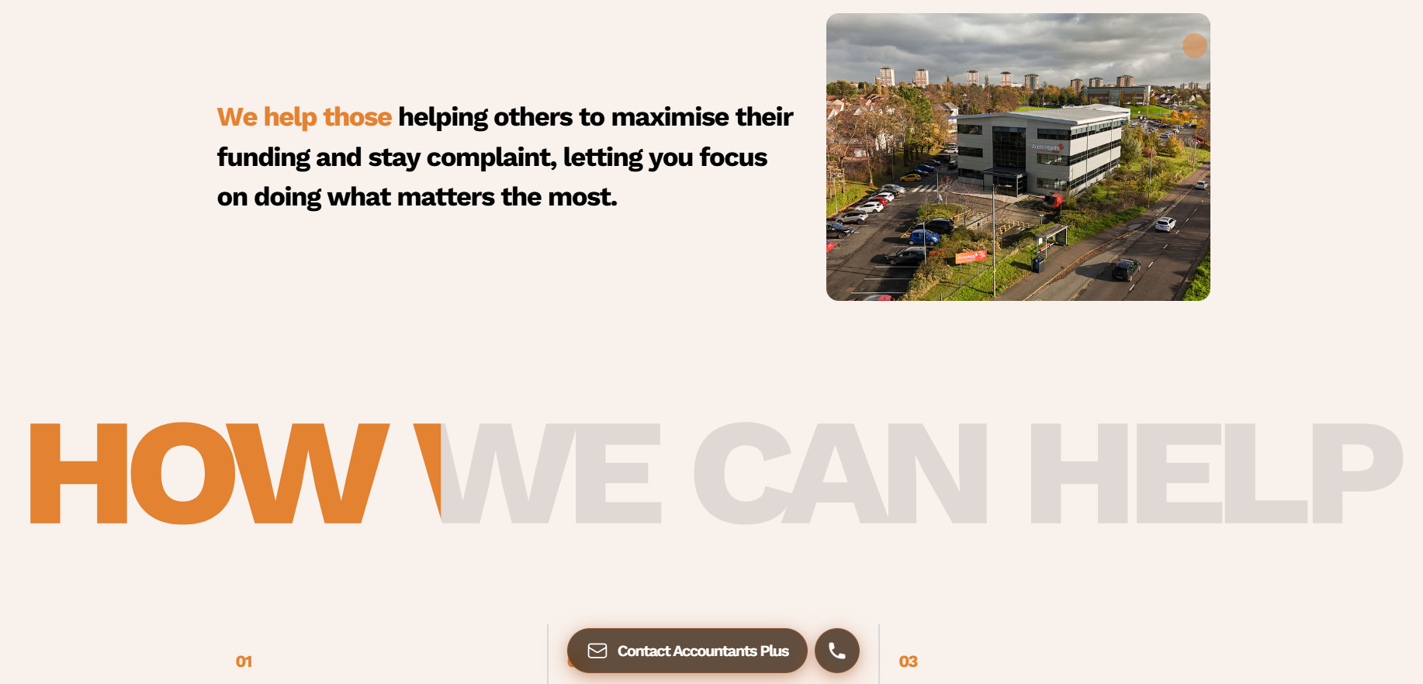
TECHNICAL
Charities SORP, increase in charities audit threshold, and changes to information displayed on OSCR website.

Slide 3
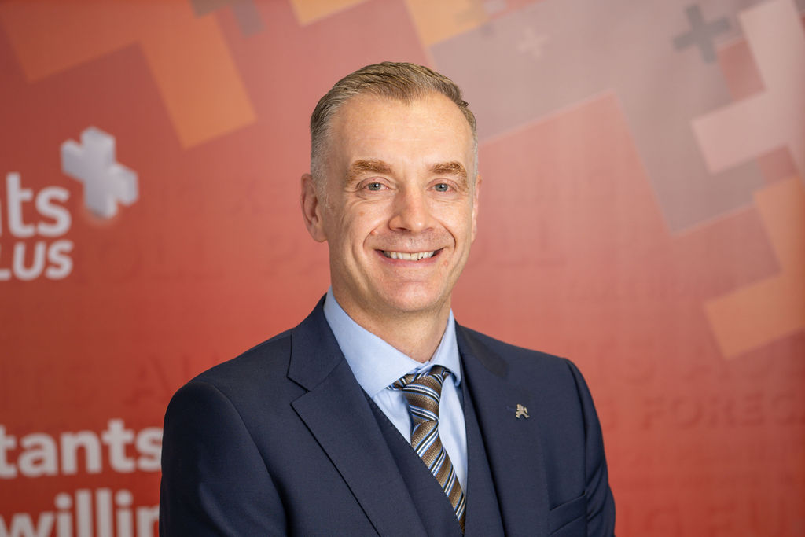
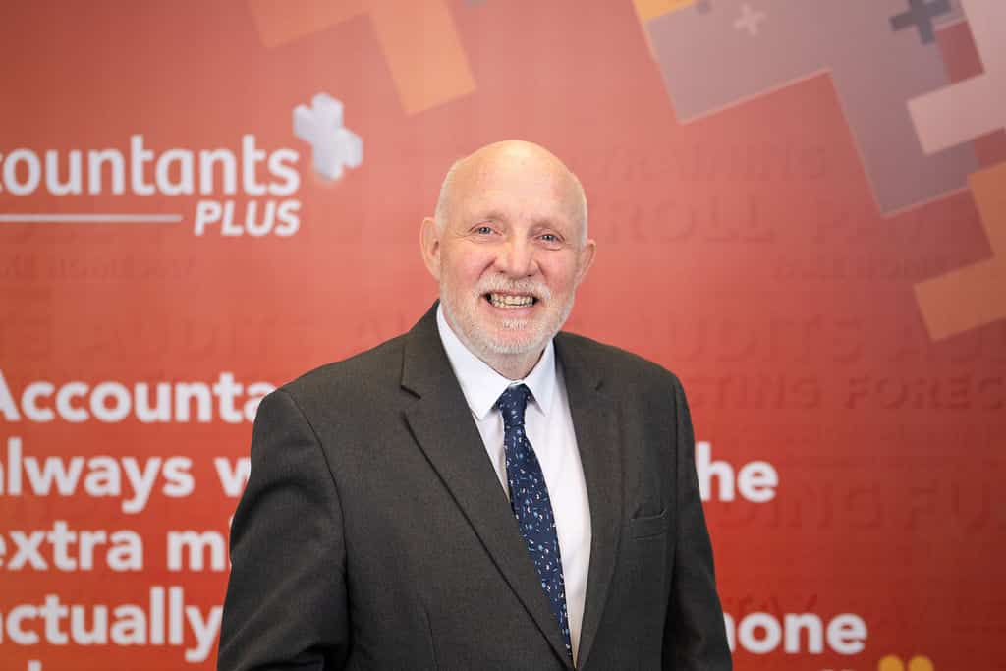
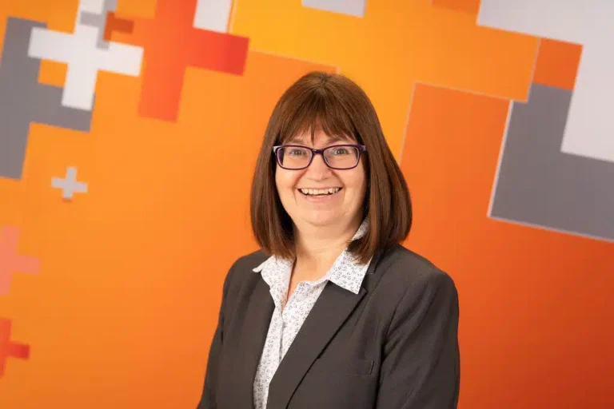
Why choose Accountants Plus
One of the top charity accountants in Scotland.
A team of specialist chartered accountants.
We work closely with the OSCR, charity commission, and other relevant regulatory bodies to keep you compliant and have developed careful processes to keep them in place for many years to come.
By choosing Accountants Plus for your charity auditing needs, you will have a charity accountant that doesn’t just help you survive, but helps you to thrive, navigating the murky waters of charity legislation, keeping you compliant and penalty free, and identifying hidden growth opportunities that could take your organisation to new heights.

Slide 4
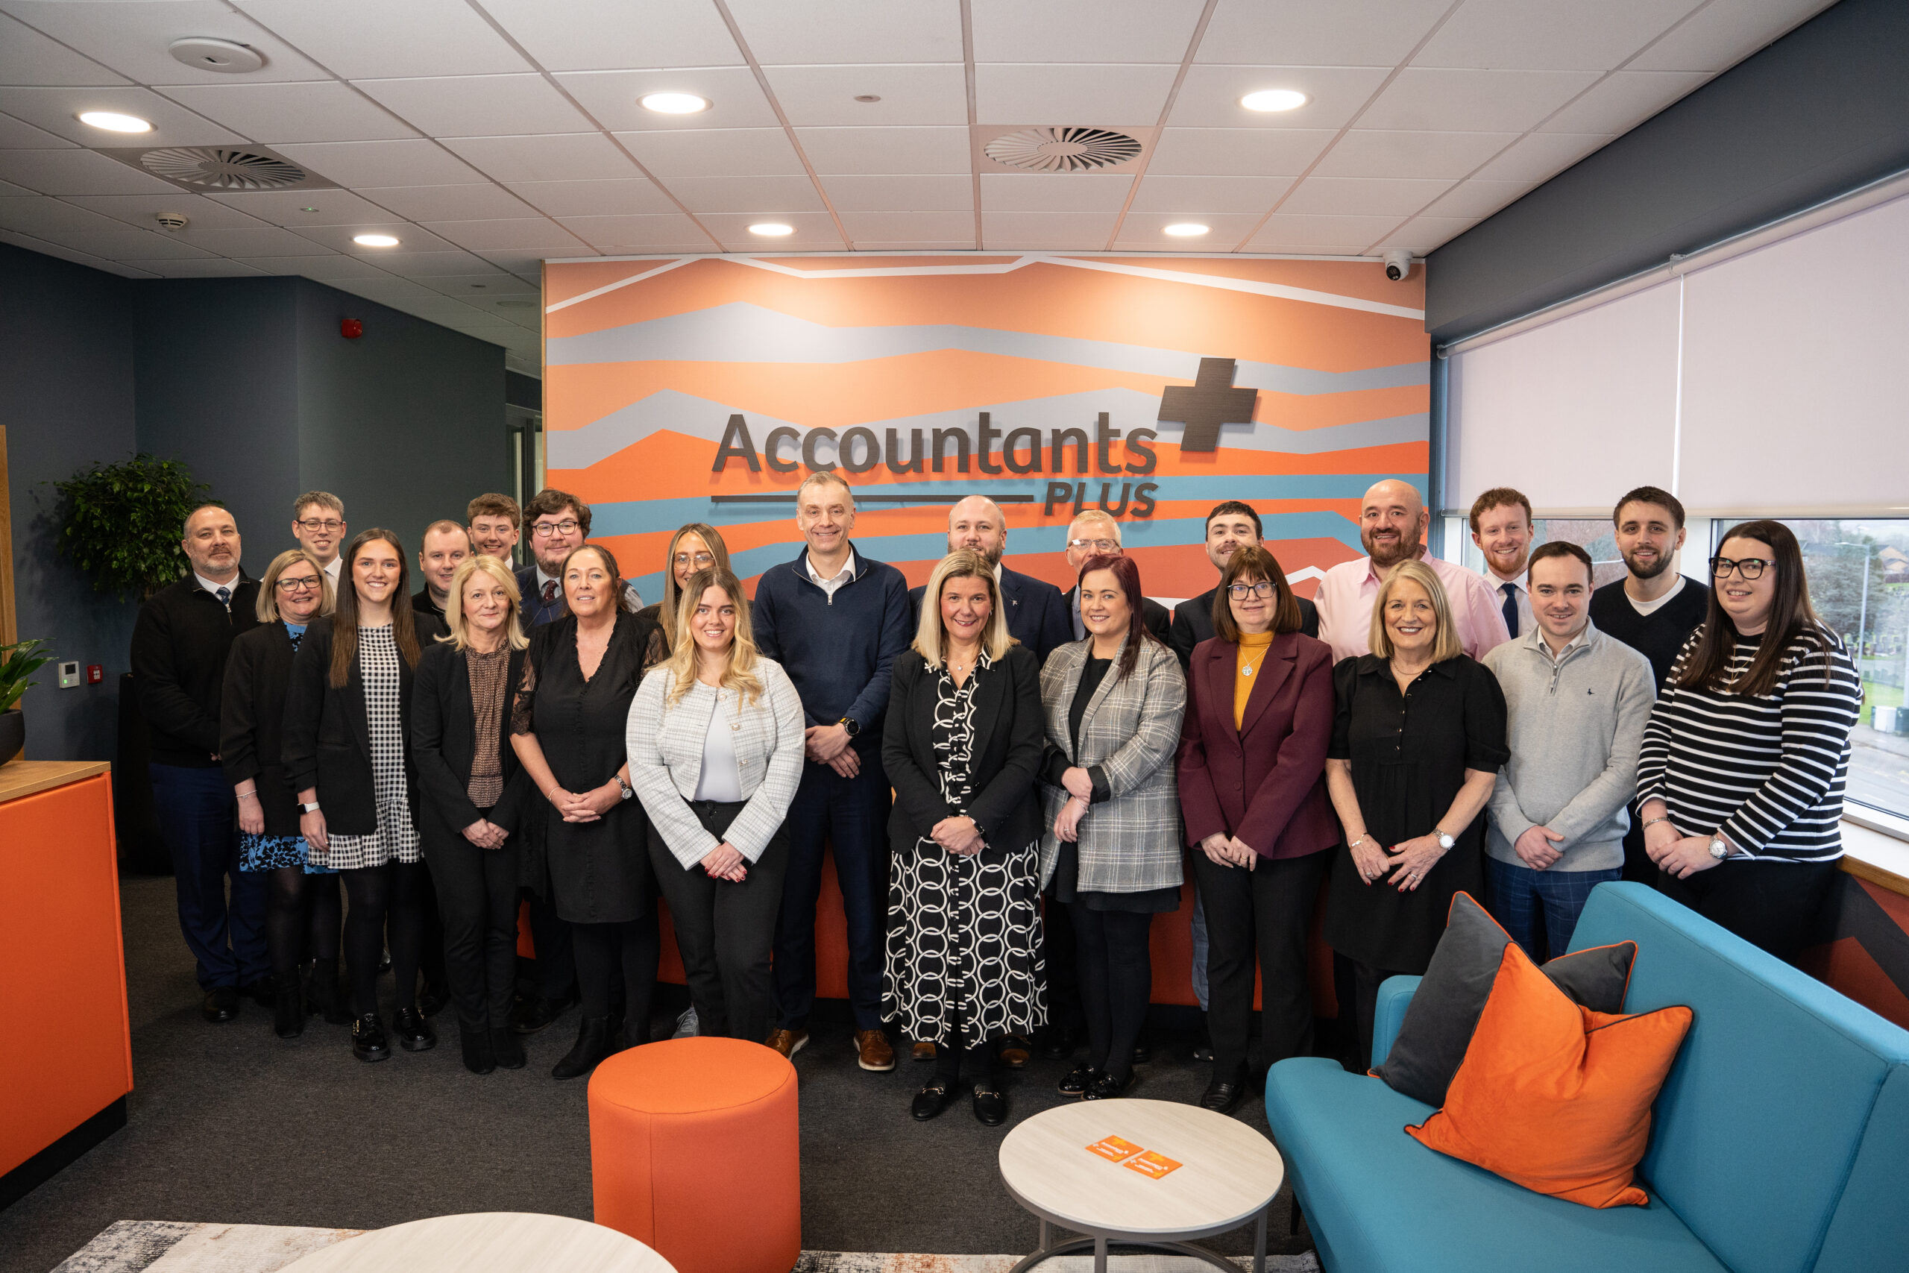
Accountancy and Audit | Taxation
Statutory Accounts and Annual Returns | Trading, Corporation Tax, and VAT
Regulator data OSCR Scottish Housing Regulator Care Commission | Gift Aid
Funder reports Tracking restricted income and expenditure | Inheritances
Financial Information IT Systems | Payroll
TEAM

Slide 5
Charity clients
Cora Foundation | Palm Church (SCIO)
Glasgow Central Mosque | UK Theatre Group SCIO
New Cumnock Development Trust | New Cumnock Development Trust
Include Me 2 Club SCIO | Biggar Youth Project SCIO
Lanarkshire Muslim Welfare Society | Riverside Inverclyde
SensationALL | Hamilton Information Project for Youth
Dynamic Gymnastics | Animal Concern
Blue Triangle | Blantyre Celtic Community Football Club
Cumbernauld & Kilsyth Nursery | HOPE For Autism
SMK Care Services | Bellshill and District Citizens Advice
Patients' Advocacy Service | Lanarkshire Community Food and Health
Excellence
in everything
we do

Slide 6
MARK MULHOLLAND FCCA
Chartered Certified Accountant
Registered Auditor

